Slide 1
CSE/PC/B/T/316 Computer Networks Topic 10- Connecting Devices
Sarbani Roy
sarbani.roy@jadavpuruniversity.in
Office: CC-5-7
Cell: 9051639328

Slide 2
Connecting devices
Hosts and networks do not normally operate in isolation. The connecting devices are mainly used to connect hosts together to make a network or to connect networks together to make an internet.
Need of connecting devices-
Separating (connecting) networks or expanding network
To connect two LANs with different protocols.
To connect a LAN to the Internet.
To split a LAN into segments to reduce traffic congestion.
To provide a security wall between two different types of users.
To connect WLAN to LAN

Slide 3
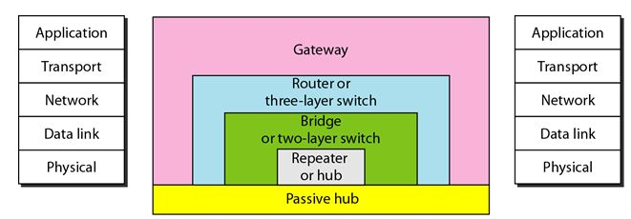
Connecting devices-Types
Connecting devices can be divided into five different categories based on the layer in which they operate in a network
Passive hub: Operate below the physical layer
Repeater or an active hub: Operate at the physical layer
Bridge or a two-layer switch: Operate at the physical and data link layers
Router or a three-layer switch: Operate at the physical, data link, and network layers
Gateway: Operate at all five layers

Slide 4
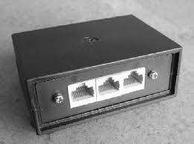
Passive Hubs
A passive hub is just a connector.
It connects the wires coming from different branches.
The signal pass through a passive hub without regeneration or amplification.
In a star-topology Ethernet LAN, a passive hub is just a point where the signals coming from different stations collide; the hub is the collision point.

Slide 5
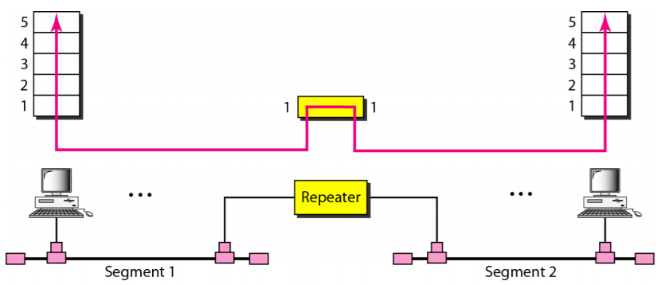
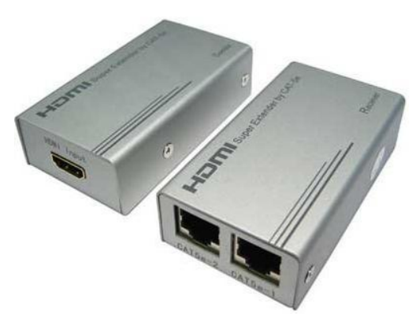
Repeaters
A repeater is a device that operates only in the physical layer.
A repeater can extend the physical length of a LAN. It can overcome the 10Base5 Ethernet length (i.e., 500m) restriction.
A repeater is NOT a device that can connect two LANs of different protocols.

Slide 6
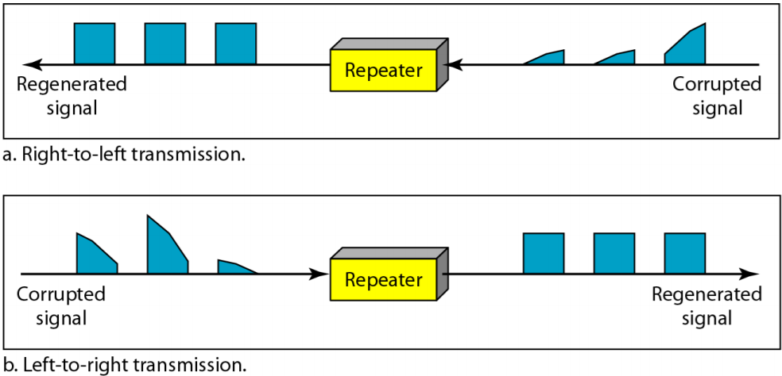
Repeaters
The repeater acts as a two-port node.
A repeater receives a signal and, before it becomes too weak or corrupted, regenerates the original bit pattern.
When it receives a frame from any of the ports, it regenerates and forwards it to the other port.
A repeater forwards every frame; it has no filtering capability.

Slide 7
Repeaters
Is Repeater also an Amplifier?
Repeater is a regenerator, not an amplifier.
An amplifier cannot discriminate between the intended signal and noise; it amplifies equally everything fed into it.
A repeater does not amplify the signal; it regenerates the signal. When it receives a weakened or corrupted signal, it creates a copy, bit for bit, at the original strength.
What is Active Hubs?
An active hub is actually a multiport repeater.
It is normally used to create connections between stations in a physical star topology.
Hubs can also be used to create multiple levels of hierarchy. The hierarchical use of hubs removes the length limitation of 10Base-T (100 m).

Slide 8
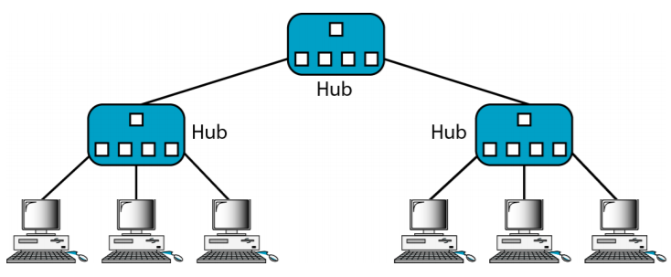
A hierarchy of hubs

Slide 9
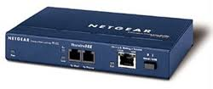
Bridges
A bridge operates in both the physical and the data link layer.
As a physical layer device, it regenerates the signal it receives.
As a data link layer device, the bridge can check the physical (MAC) addresses (source and destination) contained in the frame.
What is the difference in functionality between a bridge and a repeater?
A bridge has filtering capability. It can check the destination address of a frame and decide if the frame should be forwarded or dropped.

Slide 10
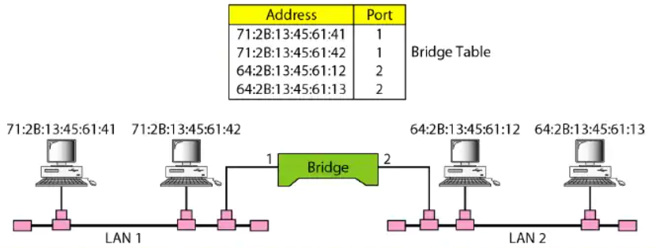
How Bridges work
When the frame enters it not only regenerates the signal it receives but also checks the source and destination addresses in the frame.
It maintains a table that maps physical addresses to ports.
It send data frames only to the concerned destination.

Slide 11
How Bridges work
Example-1: If a frame destined for station 71:2B:13:45:61:42 arrives at port 1
Consults its table to find the departing port.
According to its table, frames for 71:2B:13:45:61:42 leave through port 1.
Therefore, there is no need for forwarding and the frame is dropped.
In case of Example-1, LAN 2 remains free of traffic

Slide 12
How Bridges work
Example-2: if a frame for 71:2B:13:45:61:41 arrives at port 2
Consults its table to find the departing port.
According to its table, frames for 71:2B:13:45:61:41 leave through port 1.
The frame is forwarded.
In case of Example-2, both LANs have traffic

Slide 13
Transparent Bridges (Learning bridges)
A transparent bridge is a bridge in which the stations are completely unaware of the bridge's existence.
If a bridge is added or deleted from the system, reconfiguration of the stations is unnecessary.
Automatic learning of forwarding tables
The earliest bridges had forwarding tables that were static. The systems administrator would manually enter each table entry during bridge setup.
In case of transparent bridges, the forwarding table is automatically made by learning frame movements in the network.

Slide 14
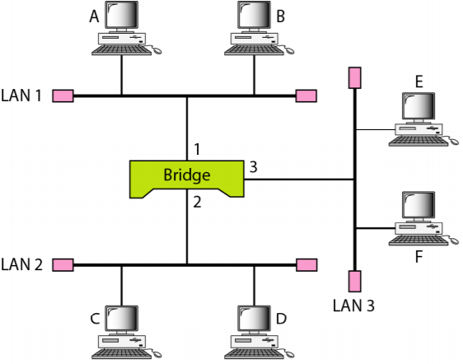
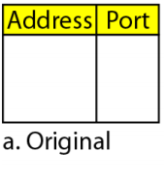
Transparent Bridges: process of learning
When station A sends a frame to station D:
The bridge does not have an entry for either D or A
The frame goes out from all three ports (i.e., there is flooding).
However, by looking at the source address, the bridge learns that station A must be located on the LAN connected to port 1

Slide 15
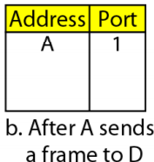
Transparent Bridges: process of learning
When station A sends a frame to station D:
The bridge does not have an entry for either D or A
The frame goes out from all three ports (i.e., there is flooding).
However, by looking at the source address, the bridge learns that station A must be located on the LAN connected to port 1
The bridge adds this entry to its table.

Slide 16
Transparent Bridges: process of learning
When station E sends a frame to station A:
The bridge has an entry for A.
So it forwards the frame only to port 1 (Note: There is no flooding).
The frame goes out from all three ports.

Slide 17
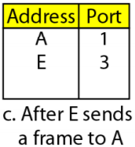
Transparent Bridges: process of learning
When station E sends a frame to station A:
The bridge has an entry for A.
So it forwards the frame only to port 1 (Note: There is no flooding).
The frame goes out from all three ports.
It uses the source address of the frame, E, to add a second entry for E to the table.

Slide 18
Transparent Bridges: process of learning
When station B sends a frame to C:
The bridge has no entry for C.
So once again it floods the network, i.e., the frame goes out from all three ports.

Slide 19
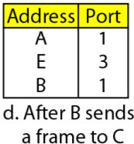
Transparent Bridges: process of learning
When station B sends a frame to C:
The bridge has no entry for C.
So once again it floods the network, i.e., the frame goes out from all three ports.
Adds one more entry for C to the table.

Slide 20
Transparent Bridges: process of learning
When station B sends a frame to C:
The bridge has no entry for C.
So once again it floods the network, i.e., the frame goes out from all three ports.
Adds one more entry for C to the table.
The process of learning continues as the bridge forwards frames

Slide 21
Transparent bridges: Loop Problem
Redundant bridges ---> more than one bridge between a pair of LANs
Transparent bridges work fine as long as there are no redundant bridges in the system.
Systems administrators, however, like to have redundant bridges to make the system more reliable. If a bridge fails, another bridge takes over until the failed one is repaired or replaced.
Redundancy can create loops in the system

Slide 22
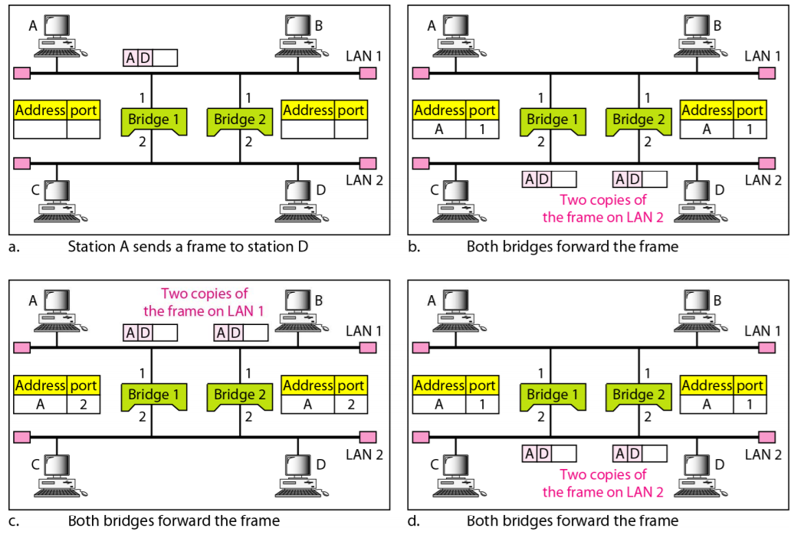
Transparent bridges: Loop Problem

Slide 23
Loop Problem: Solution
To solve the looping problem, the IEEE specification requires that switches use the spanning tree algorithm to create a loop-less topology
A spanning tree is a graph in which there is no loop.
In a bridged LAN, this means creating a topology in which each LAN can be reached from any other LAN through one path only (no loop).
We cannot change the physical topology of the system because of physical connections between cables and bridges, but we can create a logical topology that overlays the physical one

Slide 24
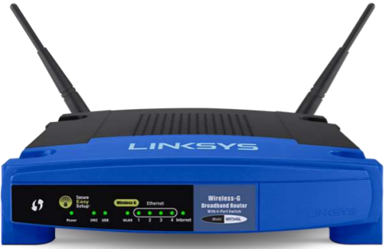
Routers
A router is a three-layer device: It operates in the physical, data link, and network layers.
As a physical layer device: It regenerates the signal it receives.
As a data link layer device: The router checks the physical addresses (source and destination) contained in the packet.
As a network layer device: A router checks the network layer addresses (addresses in the IP layer).

Slide 25
Routers
Routes packets based on their logical addresses (host-to-host addressing).
A router normally connects LANs and WANs in the Internet and has a routing table that is used for making decision about the route.
The routing tables are normally dynamic and are updated using routing protocols.
Routers can increase network efficiency by filtering out broadcast traffic between networks, thus reducing unnecessary traffic between networks.

Slide 26
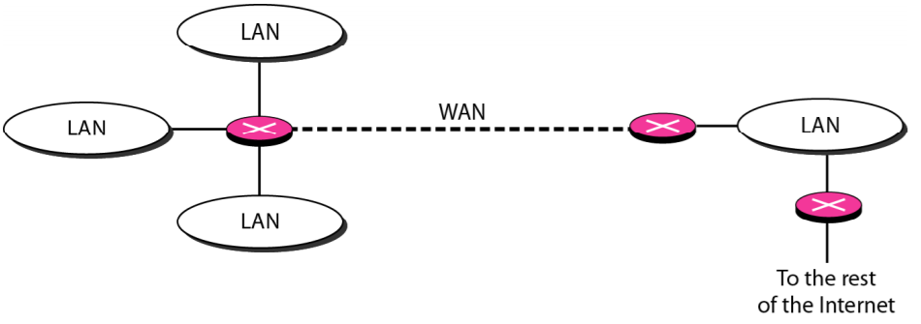
Routers connecting independent LANs and WANs

Slide 27
Differences between a router and a repeater or a bridge
A router has a physical and logical (IP) address for each of its interfaces.
A router acts only on those packets in which the physical destination address matches the address of the interface at which the packet arrives.
A router changes the physical address of the packet (both source and destination) when it forwards the packet.

Slide 28
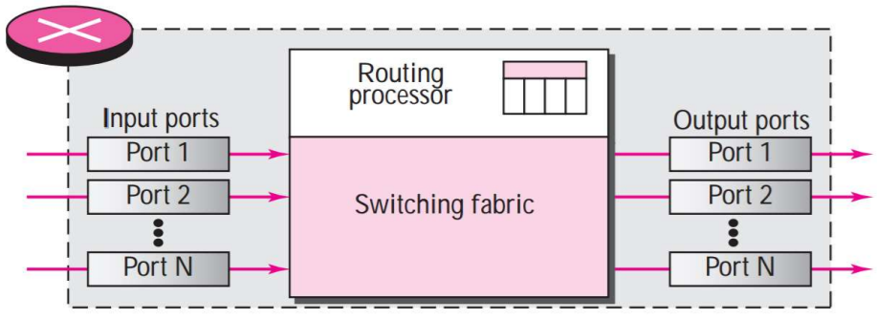
Components of a Router
The router has four components :
Input ports
Output ports
Routing processor
Switching fabric

Slide 29
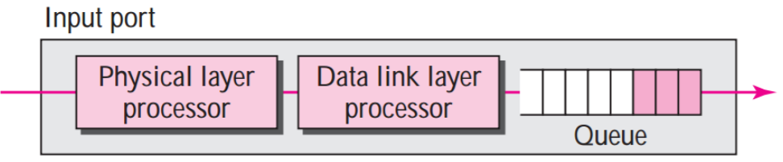
Components of a Router: Input ports
An input port performs the physical and data link layer functions of the router.
The bits are constructed from the received signal.
The packet is decapsulated from the frame.
Errors are detected and corrected.

Slide 30
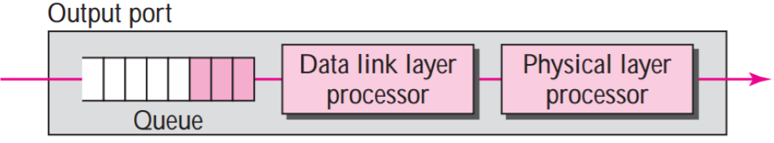
Components of a Router: Output ports
An output port performs the same functions as the input port, but in the reverse order.
First the outgoing packets are queued, then the packet is encapsulated in a frame.
And finally the physical layer functions are applied to the frame to create the signal to be sent on the line.

Slide 31
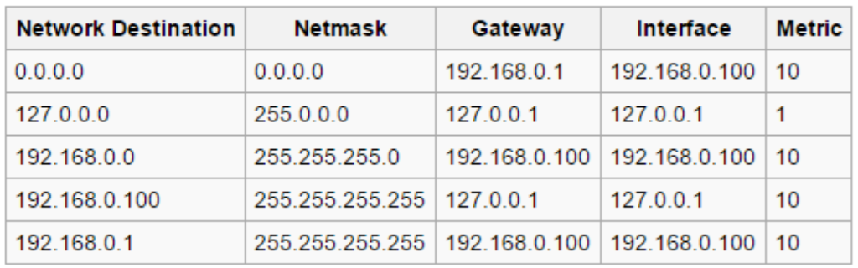
Components of a Router: Routing processor
The routing processor performs the functions of the network layer .
The destination address is used to find the address of the next hop.
This activity is sometimes referred to as table lookup because the routing processor searches the routing table.

Slide 32
Components of a Router: Switching fabric
The most difficult task in a router is to move the packet from the input queue to the output queue.
The speed with which this is done affects the size of the input/output queue and the overall delay in packet delivery
Routers use a variety of switching fabrics. Some of the switching fabrics are Crossbar Switch, Banyan switch

Slide 33
Gateway
A gateway is normally a computer that operates in all five layers of the Internet (TCP/IP) or seven layers of OSI model.
Unlike a router a gateway can forward packets across different networks that may also use different protocols.
For example, If network A is token ring network using TCP / IP and network B is in a Ethernet network, a gateway can relay frames between these two networks.
A network designed to use the OSI model can be connected to another network using the Internet (TCP/IP) model.
It has abilities to translate between different frame formats and also between different protocols.

